Slide 1


Decentralized Edge Intelligence for LoRaWAN: Federated Learning for Environment-Driven Path Loss and Link Quality Modeling
Presented by:
Pratik Khadka
Supervisor:
First Supervisor: Kristof
Second Supervisor: Nahshon M. Obiri

Slide 2
Old project:
LoRaWAN in Indoor Office Environments: Environmental Effects on Path Loss and Signal Reliability
6 × Arduino MKR WAN 1310 nodes in an indoor office, with SCD41, BME280, SPS30 sensors.
Collected ≈1,328,334 rows of data over ~4 months: temperature, humidity, CO₂, pressure, PM2.5, plus RSSI, SNR, SF.
Trained centralized models (MLR, RF, XGBoost) to predict path loss. Best: XGBoost, R² ≈ 0.93, RMSE ≈ 5.14 dB.​
Distilled a lightweight neural network using pseudo‑labels from XGBoost and converted it to TensorFlow Lite for edge deployment (TinyML).​
Built a Flutter dashboard with MQTT + PostgreSQL for real‑time visualization (but the main intelligence still lived in the server training).​
So: old project = “centralized train‑once model + visualization”, not a continuously adapting network.
Decentralized Edge Intelligence for LoRaWAN: Federated Learning for Environment-Driven Path Loss and Link Quality Modeling

Slide 3
New thesis: core concept of the upgrade
Title direction: “Decentralized Edge Intelligence for LoRaWAN: Federated Learning for Environment‑Driven Path Loss and Link Quality Modeling.”
Main change:
From >centralized data → single model
To >distributed on‑device learning → federated aggregation (TinyML on each node + FL rounds on the backend).​
Key Analogy:
Each node is a student with its own notes (local data).
They send the teacher what they learned (model updates, not raw data).
The teacher combines updates into a better shared guide (global model) and occasionally sends it back.
Decentralized Edge Intelligence for LoRaWAN: Federated Learning for Environment-Driven Path Loss and Link Quality Modeling

Slide 4
Feature options for the TinyML model:
We designed two feature‑set variants for the node’s model:
1. Pure local features (no gateway feedback~downlink)
Only what the node truly knows, free to sample at high rate:
Environmental: temp, humidity, CO₂, pressure, PM2.5.
Radio config: SF, TX power, uplink interval / mode.
Local history:
Moving average of recent predictions.
Time since last downlink.
Count of missed expected downlinks (if you use confirmed uplinks).
This variant works even if you never use downlinks for link metrics.
Decentralized Edge Intelligence for LoRaWAN: Federated Learning for Environment-Driven Path Loss and Link Quality Modeling

Slide 5
Feature options for the TinyML model:
2. With occasional feedback (coarse network view)
Because TTN allows ~10 downlinks/day/device, we treat gateway feedback as coarse, slow feedback:​
Aggregated uplink RSSI (e.g., average over last N packets).
Aggregated uplink SNR.
Packet delivery ratio (PDR) summary.
Optional network “link state” flags or ADR‑like SF recommendations.
These arrive rarely, so they cannot be the main training signal, but they can:
Calibrate thresholds (“what counts as degraded”),
Provide a slow “network view” feature for the TinyML model.
We explicitly agreed: 10 such feedback points/day are too few for dense training, but fine for slow calibration and extra context.
Decentralized Edge Intelligence for LoRaWAN: Federated Learning for Environment-Driven Path Loss and Link Quality Modeling

Slide 6
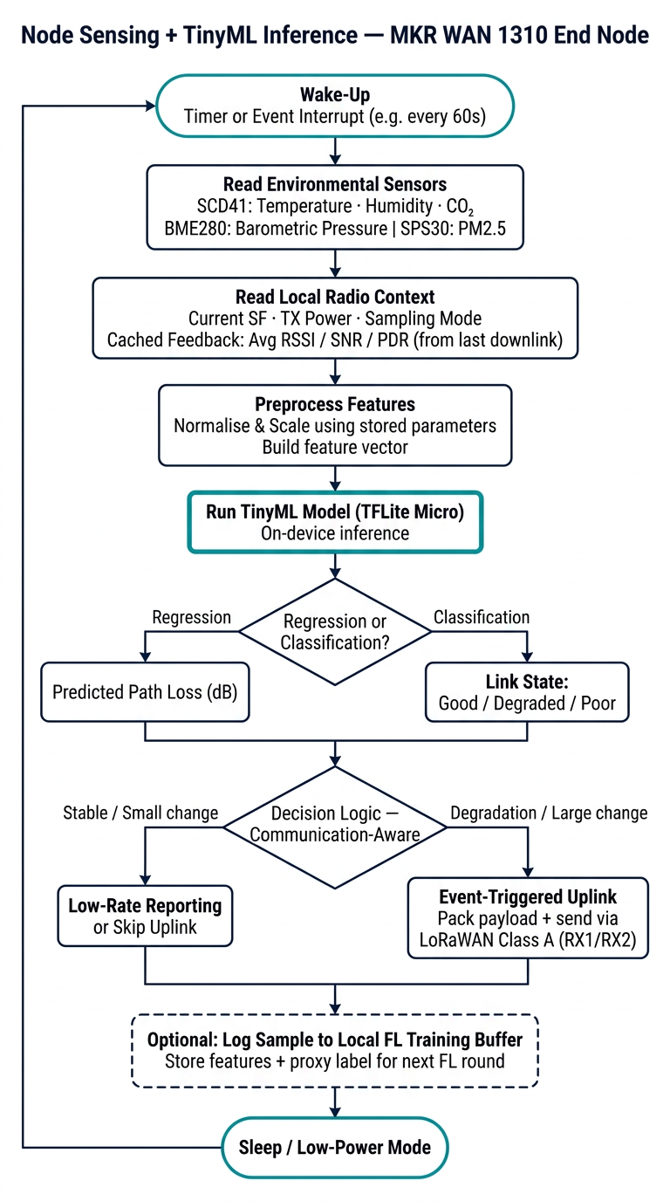
TinyML on the node: what it actually does:
Run a small model on-device to predict current path loss / link state and make communication‑aware decisions (when/how often to transmit), and to produce local model updates for federated learning.
Decentralized Edge Intelligence for LoRaWAN: Federated Learning for Environment-Driven Path Loss and Link Quality Modeling

Slide 7
Where the ground truth / labels come from now
We clarified a critical point: nodes do not need the old 1.3M‑row dataset during deployment.
The old dataset is used offline to:
Train a strong centralized teacher (XGBoost).​
Distill an initial TinyML student model.​
Provide central baselines (accuracy, RMSE) for your evaluation.
During live FL, nodes use proxy labels, e.g.:​​
For link state classification:
“Good” = downlink/ACK received.
“Degraded” or “poor” = repeated missed downlinks, low PDR.
For path loss regression (harder):
Use TX power minus occasional downlink RSSI as a rough path-loss estimate, or
Occasionally query server inference (teacher model) and treat those as pseudo-labels.
So live FL is self‑contained, using online proxy labels; old data is for pretraining and benchmarking, not for continuous streaming
Decentralized Edge Intelligence for LoRaWAN: Federated Learning for Environment-Driven Path Loss and Link Quality Modeling

Slide 8
Literature anchors:
FL + TinyML on IoT MCUs (surveys, techniques).
**** Y. Hasan et al., "Federated learning and TinyML on IoT edge devices: Challenges, advances, and future directions," ICT Express, vol. 11, no. 4, pp. 754–768, Aug. 2025.​ 🔗 https://www.sciencedirect.com/science/article/pii/S2405959525000839
**** A. Casolo and S. Russo, "Federated learning for IoT devices: Enhancing TinyML with on-board training," Information Fusion, vol. 104, p. 102189, 2024.​ 🔗 https://dl.acm.org/doi/10.1016/j.inffus.2023.102189
**** M. Alrifai et al., "A Survey on Federated Learning for TinyML: Challenges, Techniques, and Future Directions," Zenodo, Apr. 2025, doi: 10.5281/zenodo.15240508.​ 🔗 https://zenodo.org/records/15240508
FL over LoRa / LoRaWAN (case studies, simulators).
**** O. Torres Sanchez et al., "Federated Learning framework for LoRaWAN-enabled IIoT communication: A case study," arXiv, Oct. 2024, arXiv:2410.11612.​ 🔗 https://arxiv.org/abs/2410.11612
**** N. Llisterri Giménez et al., "Embedded federated learning over a LoRa mesh network," Pervasive and Mobile Computing, vol. 93, p. 101819, Jun. 2023.​ 🔗 https://www.sciencedirect.com/article/pii/S1574119223000779
TinyML on MCUs (on-device inference, distillation, compression).
**** S. Heydari and Q. H. Mahmoud, "Tiny Machine Learning and On-Device Inference: A Survey of Real-World Applications," Sensors, vol. 25, no. 10, p. 3191, May 2025, doi: 10.3390/s25103191.​ 🔗 https://pmc.ncbi.nlm.nih.gov/articles/PMC12115890/
**** N. N. Alajlan and D. M. Ibrahim, "TinyML: Enabling of Inference Deep Learning Models on Ultra-Low-Power IoT Edge Devices for AI Applications," Micromachines, vol. 13, no. 6, p. 851, May 2022, doi: 10.3390/mi13060851.​ 🔗 https://pmc.ncbi.nlm.nih.gov/articles/PMC9227753/
Decentralized Edge Intelligence for LoRaWAN: Federated Learning for Environment-Driven Path Loss and Link Quality Modeling

Slide 9




LoRaWAN in Indoor Office Environments: Environmental Effects on Path Loss and Signal Reliability
22.07.2025
Obiri, N. M., & Van Laerhoven, K. (2024). A Comprehensive Data Description for LoRaWAN Path Loss Measurements in an Indoor Office Setting. IEEE Access. DOI: 10.1109/ACCESS.2024.0429000

